Slide 1

11 Webinars and Large Meetings

Slide 2






















Be more productive with Microsoft Teams apps for meetings

Slide 3





Enhance your meeting experiences
Simplify day-to-day work with apps and workflows
Promote employee well-being
Connect people to drive culture, change, and communication

Slide 4



















Top Scenarios
Conduct quick surveys, polls, and interactions for consensus and engagement
Stay on top of your team's tasks, action items, next steps
Efficiently manage your meeting agenda and stay abreast of meeting decisions
Schedule and conduct great interviews and structured conversations
Range
HireVue Interviews
Pigeonhole Live
Polly
Phenom
Forms
Talview
Slido
Q&A
Asana
xMatters
monday.com
Priority Matrix
Decisions
qbo
SoapBox

Slide 5
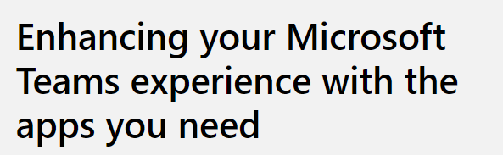
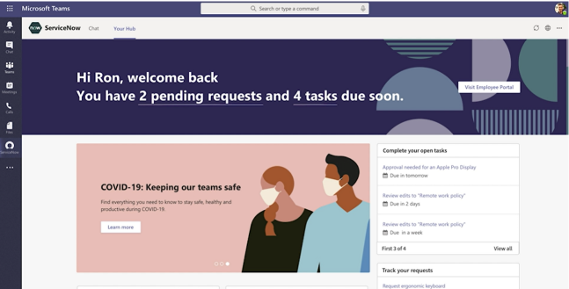
Resources
Announcement Blog Posts
https://aka.ms/meetingsapps/blog
Apps in Meetings Home Page
https://aka.ms/meetingsapps/home
Developer Documentation
https://aka.ms/meetingsapps/devdocs
John Moore – All Meetings Apps https://youtu.be/hCccXRGeLCw

Slide 6
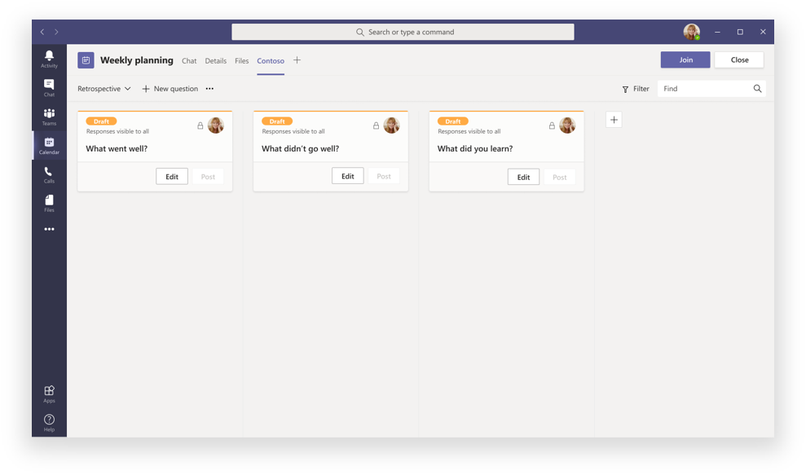
Pre-Meeting

Slide 7
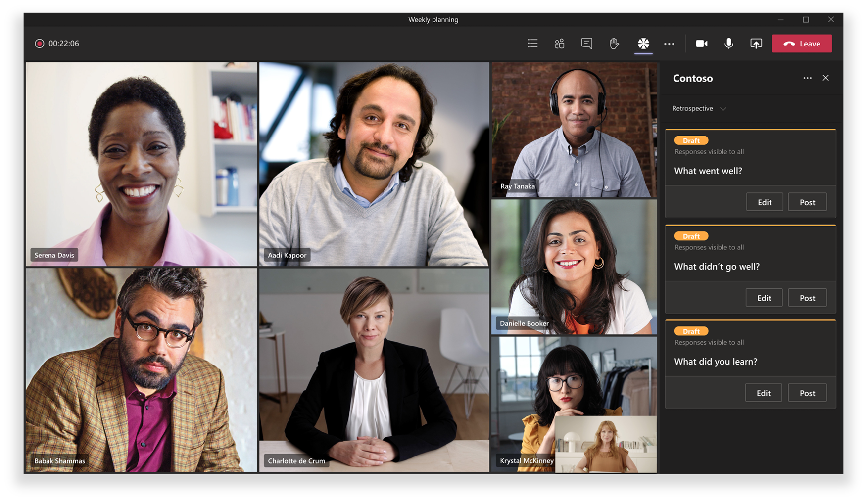
In-Meeting Side Panel

Slide 8
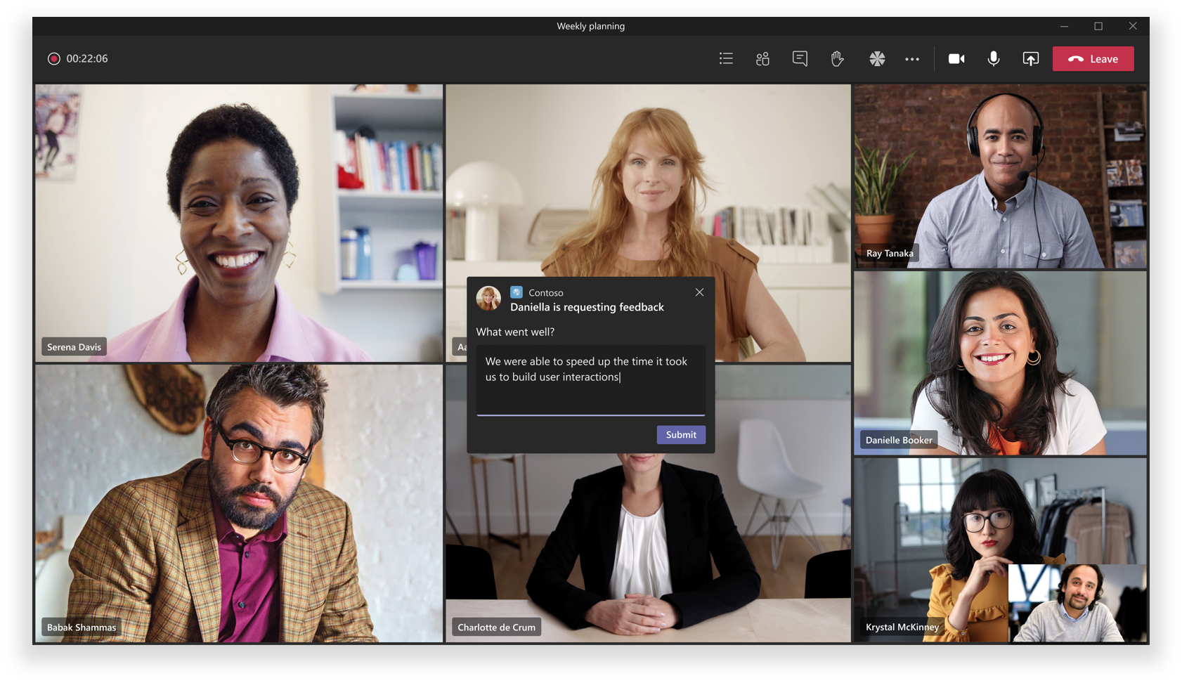
In-Meeting Dialog

Slide 9
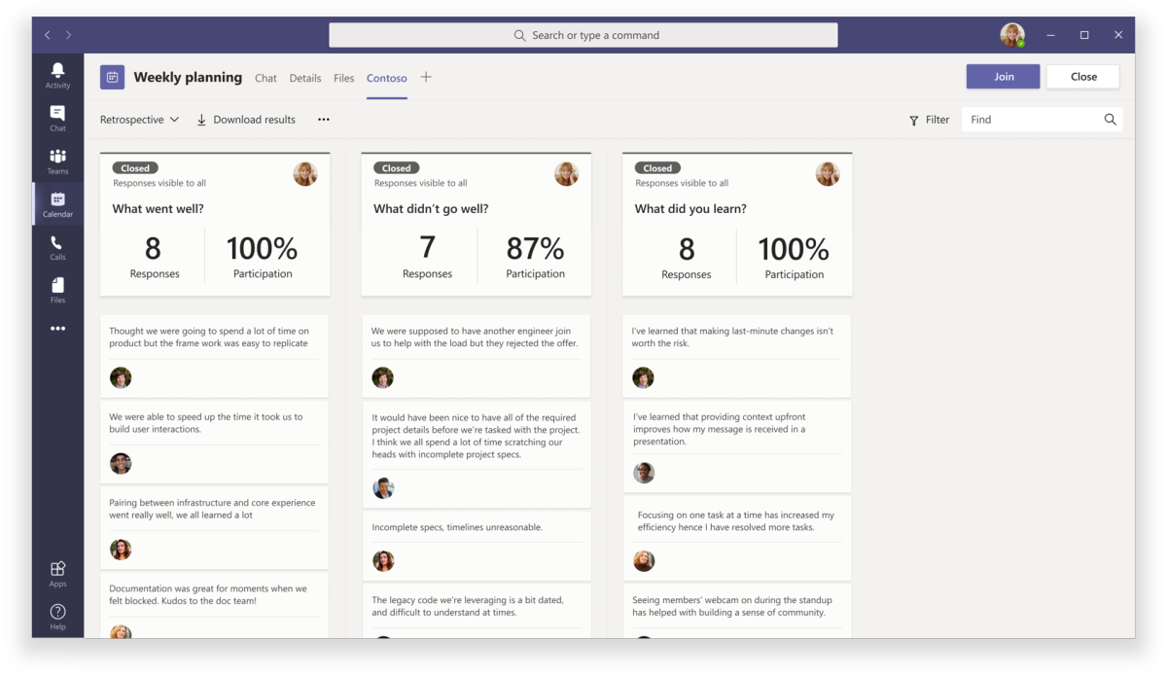
Post-Meeting Experience

Slide 10
Post-Meeting Experience

Slide 11

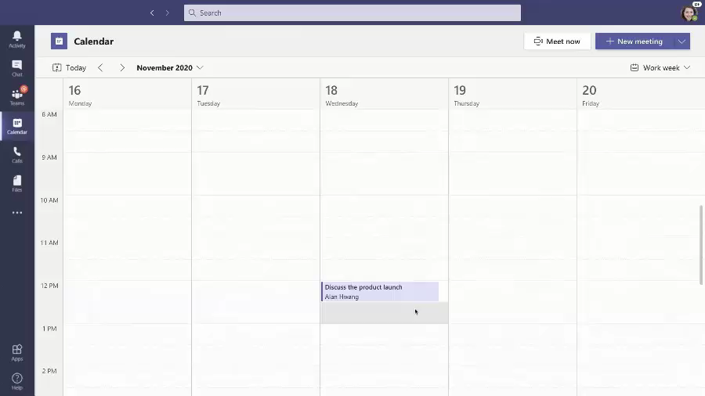
Example: Asana for Microsoft Teams
Add Asana as a meeting tab to stay on top of tasks right inside Teams.
Enable co-workers to stay abreast of tasks, blockers and timelines before a meeting.
Provide pre-meeting access to tasks and enable peers to update the task status for quicker discussions.
Discuss tasks and update their status within a meeting for efficient task management with context.

Slide 12



































Introduction
Teams Apps | Teams Platform | Apps in Teams
What Are They?

Slide 13

A single hub for work, aligned to key business scenarios, that maximizes the flow of work
Ready-to-use packaged apps for specific scenarios
Simple low code/no code apps
that maintain the flow of work and surface business processes
Custom integrations into Line-of-Business Systems

Slide 14






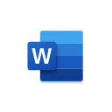









Engage your people where they already are
Vertical solutions
Healthcare
Manufacturing
Retail
Banking
Custom
Apps
Organization-based applications
Departmental tools
Employee resources
Support & info
Processes & workflow
Partner applications
Ready to use
Office 365
applications

Slide 15




How Do They Show Up?
Personal apps than open in one click in a single pane of glass
Notifications drive action and timely responses – used sparingly
Tabs provide team-focused context to shared activity
Rich cards enable smart sharing from chats/channels
Bots drive focused queries in the conversation flow
Policies determine context and focus for mobile and first line workers
PowerApps and SharePoint Framework bridge existing solutions

Slide 16







What’s In it for Us?
Common customer pain points in business operations:
Quantified benefits of Teams as a platform:
Customers who leverage applications in Teams increase user adoption by 75%
Productivity growth enabled by Microsoft Teams platform leads to 8.8 million to 21.7 million in savings in labor cost over 3 years.
Use of bots to handle employee questions reduces the number of IT and HR support tickets by 10% to 15%.
Working with the Microsoft Teams platform delivers 1% to 5% reduction in the chance of major security breach.
Platform is a bridge builder between the business and IT. Citizen development saves $231k to $363k versus internal app development.
Organization struggle to drive adoption for productivity and data visualization tools
Employees losing time by switching applications and tools frequently
Increased risk for security related issues with the use of publicly available applications
Source: Forrester Consulting Total Economic Impact™ Of using Microsoft Teams as a platform and Teams with Power Platform

Slide 17
Next Step: Start with a Scenario . . .
Industry vertical
Airlines, transportation
Flight/route crew communication hub
Local crew shift management
Financial services
Proposal Manager for commercial banking
Content sharing with compliance
Retail and consumer goods
Supply chain real-time collaboration
Shift, pricing, and inventory management
Mining, oil, and gas
New location development
Daily quality monitoring and analysis
Government
Emergency/disaster response and recovery
Citizen service: permitting and licensing
Healthcare
Patient care coordination
Telemedicine
Manufacturing
Key accounts inventory, logistics
Change order services
Power and utilities
Field service real-time remote assist
Billing and customer management
Real estate and construction
Leasing office tenant management
Real estate customer engagement
Horizontal
Marketing
Brand partnership hub
Industry event planning
Marketing hub
HR
Recruiting tool
New hire onboarding and support tools
Project management
Billable hours management
Client engagement hub
Service desks
Self-service knowledge base
Customer service desk
Procurement center service
Firstline workers
Shift management
Remote worker task management

